Slide 1
Combined Traffic Detection App
Ann Mariya Francis
STB03000

Slide 2
Objective
The objective of the "Combined Detection App" is to provide a user-friendly interface for performing two different types of detection tasks related to traffic and safety.
"Red Light Signal Violation Detection": This option aims to detect violations of red light signals at intersections or traffic lights using image data.
"Helmet Detection and License Plate Extraction": This option is focused on detecting whether individuals are wearing helmets while riding vehicles and extracting license plate information from images if they are not wearing helmet.

Slide 3
Steps
1. Import Libraries
2. Load Pretrained Models
3. Create a Streamlit App
4. Choose between the two detection modes: “Signal Violation Detection” and “Helmet and License Plate Detection”
5. If “Signal Violation Detection” is selected: The preprocessed image is passed through the signal violation detection model.
6. If the "Helmet and License Plate Detection" mode is selected, users can upload an image for analysis. It utilizes Haar Cascade to perform detection.

Slide 4
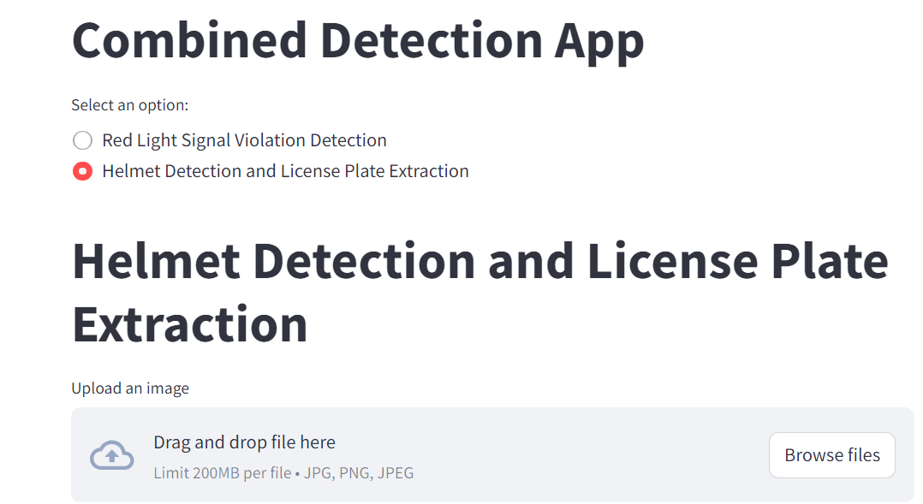
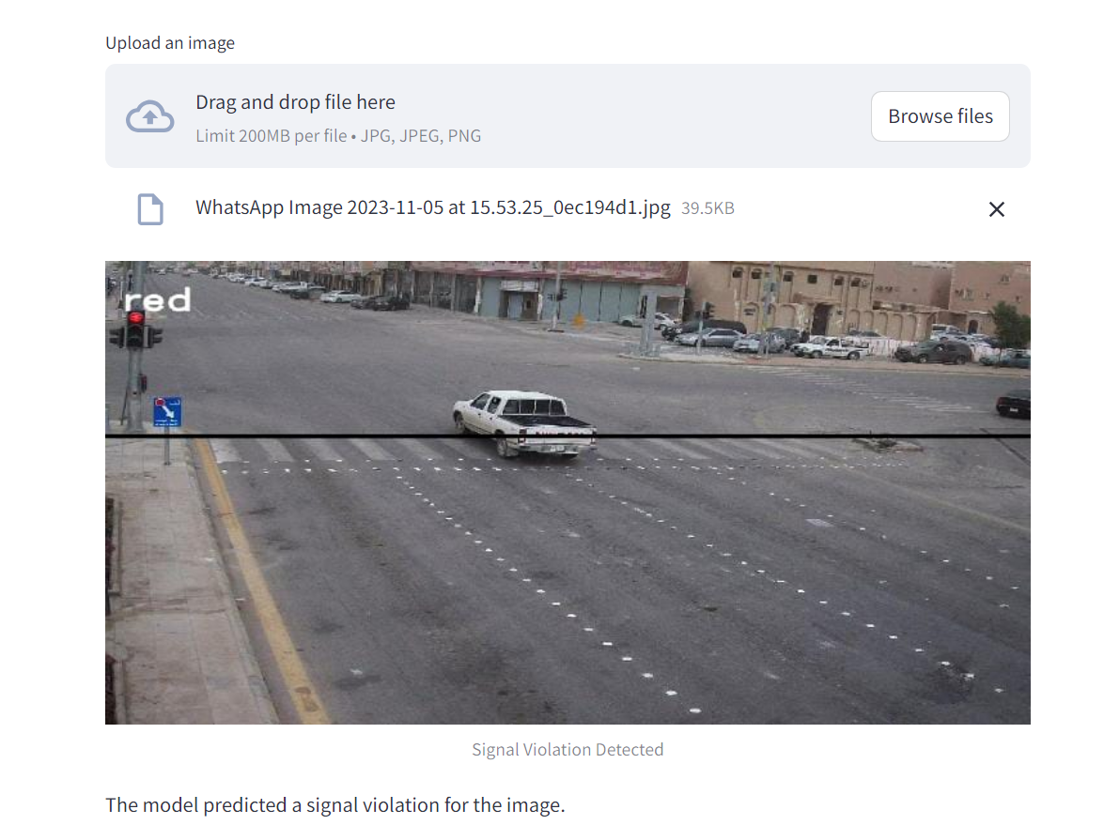

Output

Slide 5
Conclusion
The combined traffic detection app makes it easier for both traffic authorities and the general public to assess and report traffic violations.
The app empowers users to assess and analyze images for various traffic-related violations and anomalies.
This app provides a glimpse into the future of smart traffic management and enforcement and showcases the potential for technology to make our roads safer and more secure

Slide 6
Thank You

